Slide 1
Information Systems Overview
Course: Information Systems Engineering
Prepared by Dr. Abdo Darbooli

Slide 2
Course Topics
• Introduction to Information Systems (IS) Auditing
Risk in Information Systems
Internal Controls of Information Systems
• IS Auditing Procedure
• Business Application Development and the Roles of IS Auditors
Business Application Development Process
Risk of Business Application Development
Role of IS Auditors in Business Application Development
• IS Maintenance and Controls
IS Maintenance Practices
Change Management
IS Controls

Slide 3
Acknowledgment
This course is in based on:
“Information Systems Auditing, Controls and Assurance” by Prof. Garvin Percy Dias
Hong Kong University of Science and Technology

Slide 4
Introduction
An information system is a set of interrelated components that collect, manipulate, store data and disseminate information and provide a feedback mechanism to monitor performance.

Slide 5
What is an Information System?
An organized combination of people, hardware, software, communications networks, and data resources that collects data, transforms it, and disseminates information.

Slide 6
Data vs Information
Data: Raw unorganized facts
Information:
A collection of facts organized in such a way that they have additional value beyond the value of the facts themselves.
Defining and organizing relationships among data creates information.

Slide 7
Information Concepts
Process:
A set of logically related tasks performed to achieve a defined outcome.
Knowledge:
An awareness and understanding of a set of information and ways that information can be made useful to support a specific task or reach a decision

Slide 8
The Value of Information
The value of Information is directly linked to how it helps decision makers achieve their organization’s goals.
System is a set of elements or components that interact to accomplish goals.

Slide 9
Computer Based Information System (CBIS)
Hardware:
Computer Equipment
Software:
Computer Programs
Databases:
An organized collections of facts

Slide 10

Computer Based Information System (CBIS)
Telecommunications:
Electronic transmission of signals for communication
Networks: Distant electronic communication
Internet: Interconnected Networks
Intranet: Internal Corporate Network
Extranet: Linked Intranets

Slide 11

Computer Based Information System (CBIS)
People
Procedures:
Strategies, policies, methods, and rules for using a CBIS.

Slide 12
Electronic and Mobile Commerce
E-Commerce:
Any business transaction executed electronically
M-Commerce:
Transactions conducted anywhere, anytime
Relies on wireless communications

Slide 13
TPS and ERP
Transaction
business related exchange
Evidence of a business event
Transaction Processing System (TPS)
A system which records completed business transactions
Enterprise Resource Planning (ERP)
A set of integrated programs for managing the entire business operations

Slide 14
Business Information Systems

Slide 15
Business Information Systems
Management Information System:
A system used to provide routine information to managers and decision makers
Decision Support System:
A system used to support problem-specific decision making

Slide 16
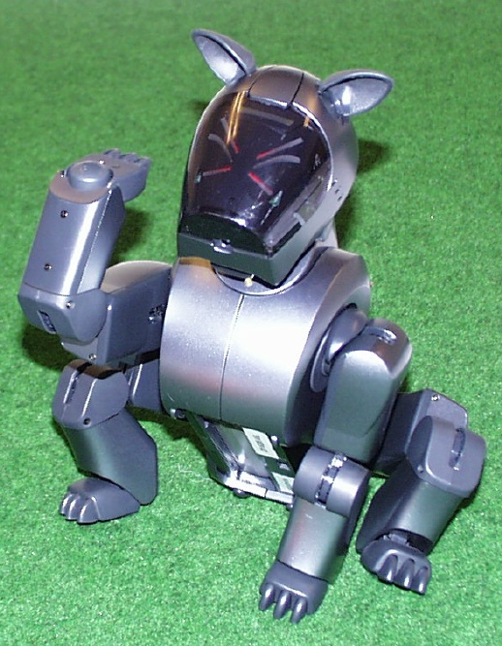
Specialized Business I.S.
Artificial Intelligence (AI):
A field in which the computer takes on the characteristics of human intelligence

Slide 17
Specialized Business I.S.
Expert System:
A system that gives a computer the ability to make suggestions and act like an expert in a particular field.
Knowledge Base:
The collection of data, rules, procedures, and relationships that must be followed to achieve value or the proper outcome.

Slide 18
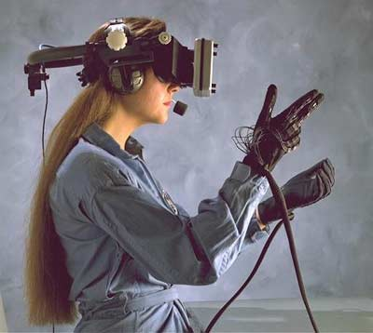
Specialized Business I.S.
Virtual Reality:
The simulation of a real or imagined environment that can be experienced visually in three dimensions

Slide 19
Systems Development

Slide 20
Systems Development
The activity of creating or modifying existing business information systems

Slide 21
Systems Development
Systems Investigation and Analysis
Understand the problem and potential solutions
Systems Design, Implementation, Maintenance and Review
Determine how the new system will meet business needs
Put the new system into operation
Ensure the system continues to meet changing business needs

Slide 22
Information Systems in Society
Security, Privacy Ethical issues in information systems and the Internet
Computer Literacy: Knowledge of computer systems and equipment and the ways they function

Slide 23
General Information Systems Diagram
Management Decisions
(Environment)
Data
Input
Process
Output
Information
Control
Feedback

Slide 24
Data vs Information
Data:
Raw unorganized facts
Information:
Data organized in a meaningful way for the user (in consideration of the environment)

Slide 25
Informal Information Systems
Each organization has a unique culture, or fundamental set of assumptions, values, and ways of doing things, that has been accepted by most of its members

Slide 26
Informal Information Systems
Environment:
Business - other functional areas
Computer – hardware, software, other IS
Sub System:
Component of a larger system
System Boundary:
Interaction with environment (user or other system) via an interface

Slide 27
Information System Activities
Input of Data Resources
Process Data into Information
Output of Information

Slide 28
Input of Data Resources
Data entry
Editing
Machine readable
Source documents
Formal record of a transaction
User interface
How users interact with information system
Optical scanning; menu; prompts; fill in blanks

Slide 29
Process Data into Information
Calculate
Compare
Sort
Classify
Summarize
The quality of the data must be maintained by a continual process of correcting and updating activities

Slide 30
Output of Information
Transmit information to users
Display; paper; audio
Storage of data
Data are retained in an organized manner
Fields; records; files; data bases
Control of system performance
Feedback must be monitored and evaluated to determine if the information system is meeting established performance standards

Slide 31
Systems Applications in the Organization
Decisions
Management Levels
Information Systems
Unstructured
Senior Management
ESS
Strategic
DSS
Knowledge and Data Worker
GIS, CAD/CAM, OAS
Tactical
Middle
Management
MIS
Lower
Management
TPS
Technical
(Operational)
Buy
Make
Sell
Keep
Track
Functions
Structured

Slide 32
End

