Slide 1
Introduction to Information Systems Auditing
Course: Information Systems Engineering
Prepared by Dr. Abdo Darbooli

Slide 2
Course Topics
• Introduction to Information Systems (IS) Auditing
  Risk in Information Systems
  Internal Controls of Information Systems
• IS Auditing Procedure
• Business Application Development and the Roles of IS Auditors
  Business Application Development Process
  Risk of Business Application Development
  Role of IS Auditors in Business Application Development
• IS Maintenance and Controls
  IS Maintenance Practices
  Change Management
  IS Controls

Slide 3
Today’s Topics
• Introduction
• Risk in a Business
• Elements of Risk
  Threats
  Impact
  Probability
• Risk Management Process
  Risk Assessment
  Risk Mitigation
  Risk Re-Evaluation

Slide 4
Acknowledgment
This course is in based on:
  “Information Systems Auditing, Controls and Assurance” by Prof. Garvin Percy Dias
    Hong Kong University of Science and Technology

Slide 5
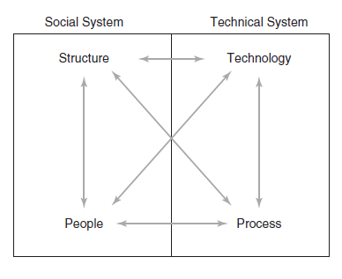
Introduction
Information technology (IT) refers to any computer-based tool that people use to work with information and to support an organization’s information and information-processing needs.
An information system (IS) collects, processes, stores, analyzes, and disseminates information for a specific purpose.
Information system components:

Slide 6
Risk in a Business
What is Risk?
  a possibility of having a negative impact
Why do we take the risk?
  Thinking of having positive impact
    Example: stocks going up

Slide 7
Elements of Risk
Threat
Impact
Probability

Slide 8
Elements of Risk - Threats
Different kinds of threats
  Natural disaster
    e.g. earthquakes
  Man-Made threats
      Internal: you are in the organization and try to steal data to sell to competitors, i.e. fraud.
      External: someone outside your organization try to hack and steal your data, i.e. hacking.
      Who can give you the highest damage??
  Technical
    e.g. hardware/software failure, network failure, data failure.

Slide 9
Elements of Risk – Impact
A measure of damage due to the threat you face
  Easily to measure
    In terms of dollars, e.g. earthquake
  Hard to measure
    What if you lost your customers and customer reputation???
    Qualitative measures
5- Major
4- Serious
3- Moderate
2- Minor
1- Negligible

Slide 10
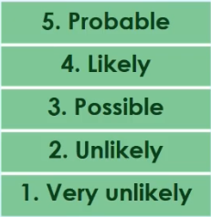
Elements of Risk – Probabilities
Likelihood of having risk
  It is a subjective task based on historical data
  Example: how likely will the next earthquake of magnitude 6.5 happen?

Slide 11
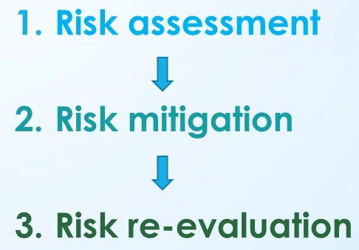
Risk Management Process

Slide 12
Risk Assessment
Identify area of having high risk
  Different organizations have different exposures (different kinds of risks to different degrees)
1- Define the Impact
2- Define the Probability of Having Risk
3- Identify the risk for different threats and
Create the Risk Matrix
4- Rate the Risk

Slide 13
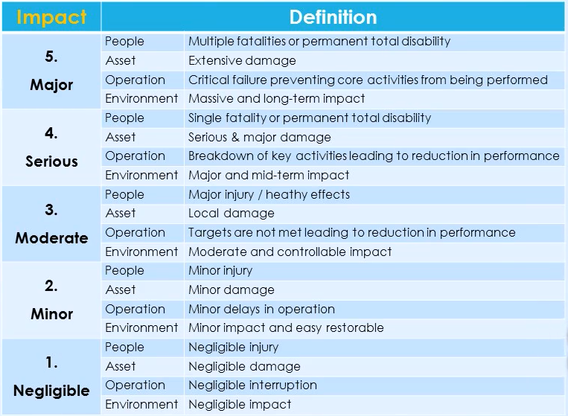
Risk Assessment – Define the Impact
Impact is mostly qualitative
Different areas of your business are going to be impacted
  People
  Asset
  Operation
  Environment
Example: Earthquake →

Slide 14
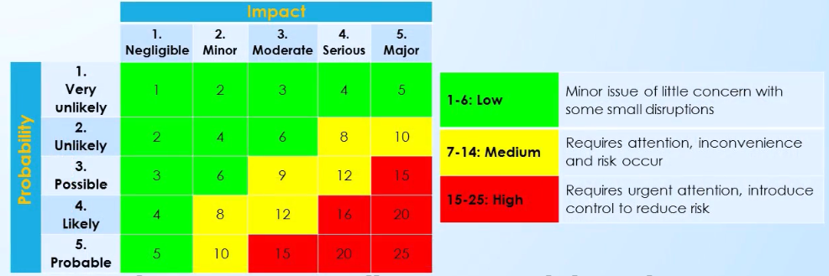
Risk Assessment – Create the Risk Matrix
For each threat: rate the risk

Slide 15
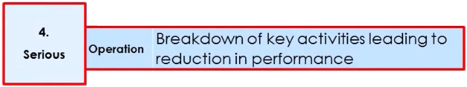
Risk Assessment – Example
Risk to your organization
  What is the threat?
    Cyber hacking to online server
  What is the impact?
  What is the probability?

Slide 16
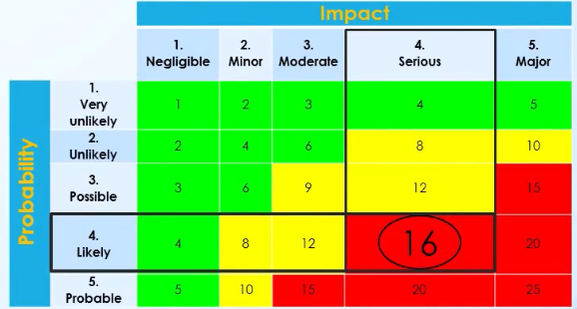
Risk Assessment – Example
It is high risk
  Needs urgent attention
  Should not continue business in high risk area

Slide 17
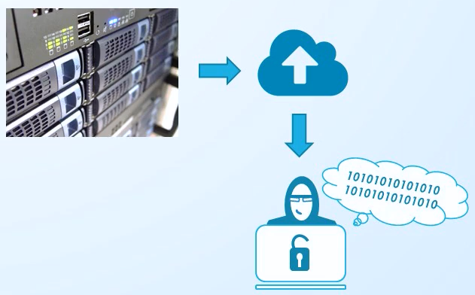
Risk Mitigation
Reduce risks using controls
How can we reduce the risk of cyber hacking?

Slide 18
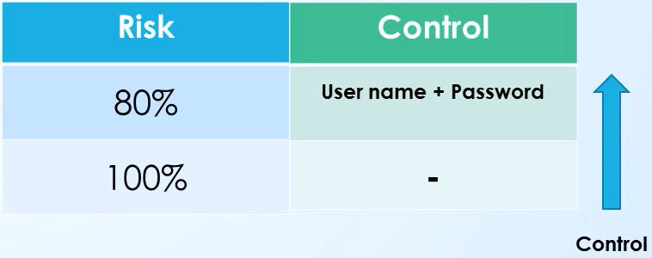
Risk Mitigation – Reduce using Controls

Slide 19
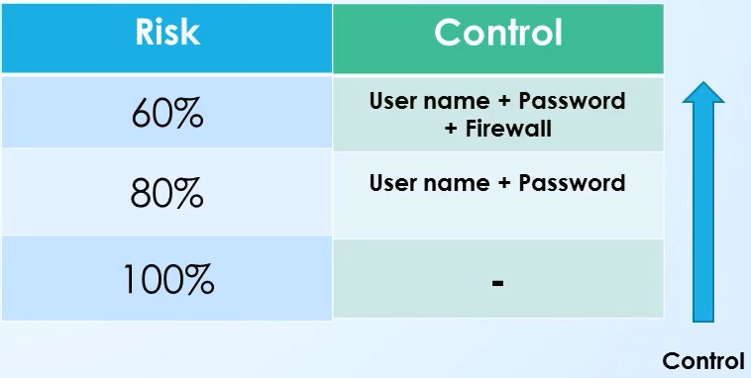
Risk Mitigation – Reduce using Controls

Slide 20
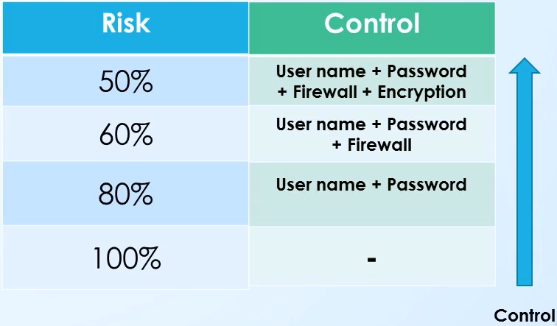
Risk Mitigation – Reduce using Controls

Slide 21
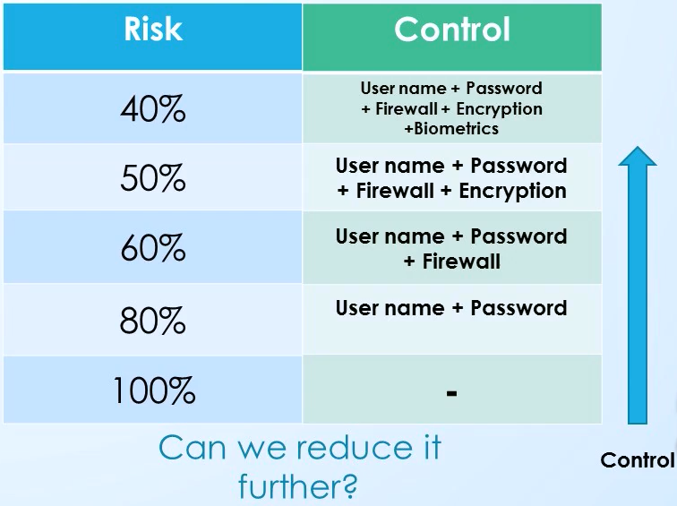
Risk Mitigation – Reduce using Controls

Slide 22
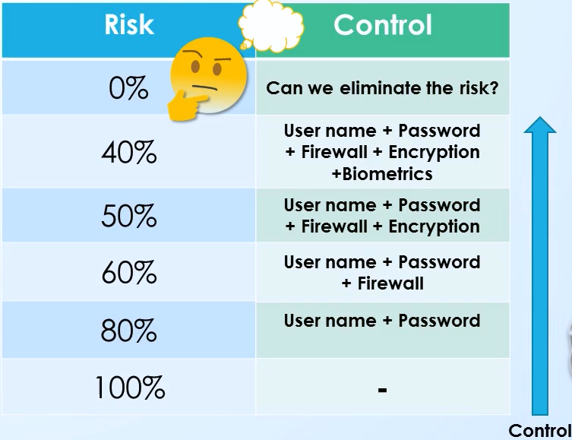
Risk Mitigation – Reduce using Controls
It is not possible to eliminate risk

Slide 23
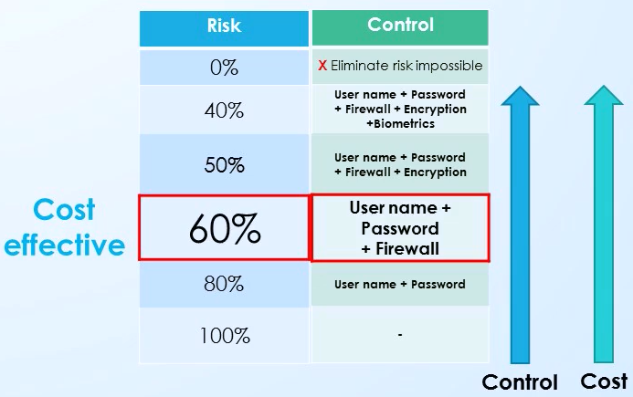
Risk Mitigation – Reduce using Controls
Which level are we going to stop and who make that decision???
  Most of the time senior management make the decision because they have to bear the ultimate responsibility

Slide 24
Risk Mitigation – Reduce using Controls
Which level are we going to stop and who make that decision???
  Most of the time senior management make the decision because they have to bear the ultimate responsibility
    Balance between cost and benefit, cost and risk

Slide 25
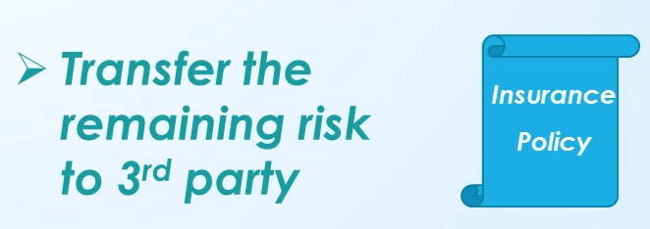
Risk Mitigation
What are the options if senior management still not happy with the existing risk??
Can we transfer it without doing any controls??
  Cost to pay would be extremely high!!

Slide 26
Risk Mitigation
What about risk avoidance???
  Last option
  Example – Transfer from banking to e-banking, think of the difference between risk eliminating and risk avoidance in this case
What if we take risk avoidance??
  Example – no e-banking, what about customers??

Slide 27

Risk Re-Evaluation
Going back to risk assessment and mitigation
When?
  Time driven
    Periodically and no external factors
  Event driven
    Environment change

Slide 28
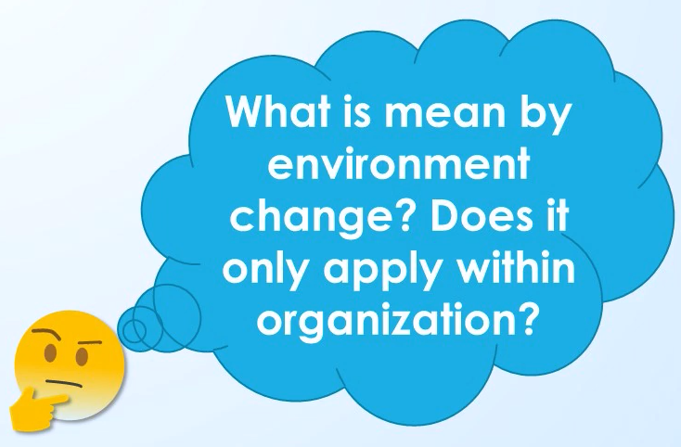
Risk Re-Evaluation
Environment change
  Something changed within organization or similar organizations
    E-banking, Covid-19
  Government regulation
  Natural disaster

Slide 29
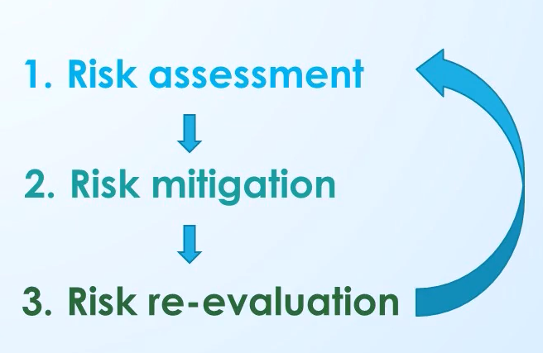
Risk Management Process

