Slide 1

Internal Controls of Information Systems
Faculty of Engineering
Informatics Department
Course: Information Systems Engineering
Prepared by Dr. Abdo Darbooli

Slide 2
Course Topics
• Introduction to Information Systems (IS) Auditing
Risk in Information Systems
Internal Controls of Information Systems
• IS Auditing Procedure
• Business Application Development and the Roles of IS Auditors
Business Application Development Process
Risk of Business Application Development
Role of IS Auditors in Business Application Development
• IS Maintenance and Controls
IS Maintenance Practices
Change Management
IS Controls

Slide 3
Today’s Topics
• Introduction
• What are Internal Controls?
• Classification of Internal Controls
• Internal Controls Example

Slide 4
Acknowledgment
This course is in based on:
“Information Systems Auditing, Controls and Assurance” by Prof. Garvin Percy Dias
Hong Kong University of Science and Technology

Slide 5
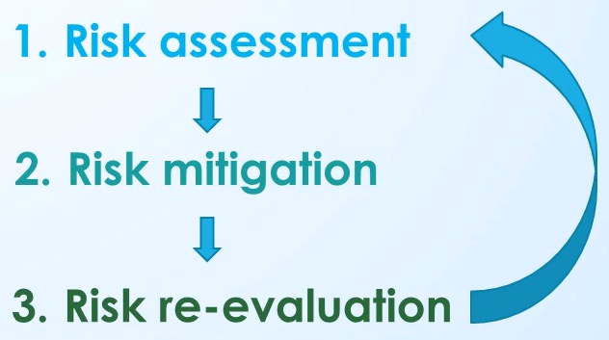
Introduction
In the previous lecture, we talked about risk management and we have seen that we can manage the risk, or reduce the risk, using controls.
Controls are extremely important to reduce the risk.
In this lecture:
Try to understand what are the different kinds of controls we have?
What are those?
How those controls can reduce the risk?

Slide 6
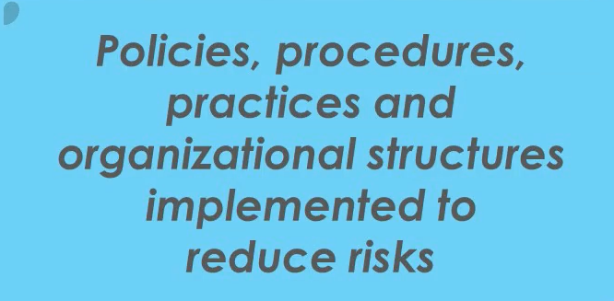
What are Internal Controls

Slide 7

Example of Internal Control
You have your data within your organization and you want to reduce the risk.
The control could come from your senior management and all the data kept in your server has to be encrypted.
That's the policy, procedure from your senior management, but somebody might steal your username and password???
Policy and Procedure
Every employees must change their usernames and passwords every 3 months

Slide 8
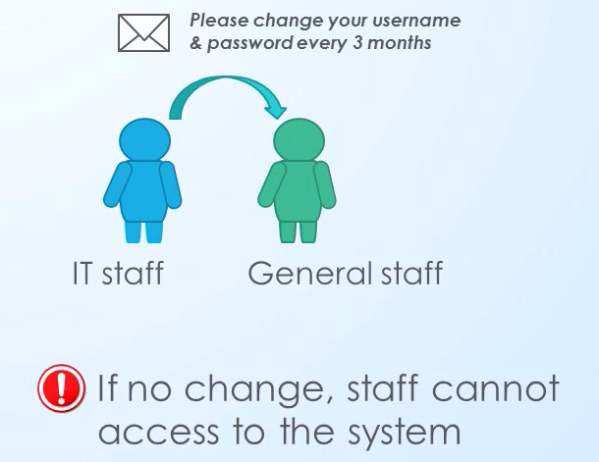
Example of Internal Control (cont’d)
How to implement this policy?
Policies and procedures would be implemented by the IT people as controls.
IT people might send an email to all the employees to change
What if employees simply delete that email?

Slide 9
Internal Controls
Policy and procedures
Law and regulations from government

Slide 10
Classification of Internal Controls
Preventive Controls
Example - Antivirus software on your computer
Detective Controls
Example - Firewall used by system administrator
Corrective Controls
Example – Backup data

Slide 11
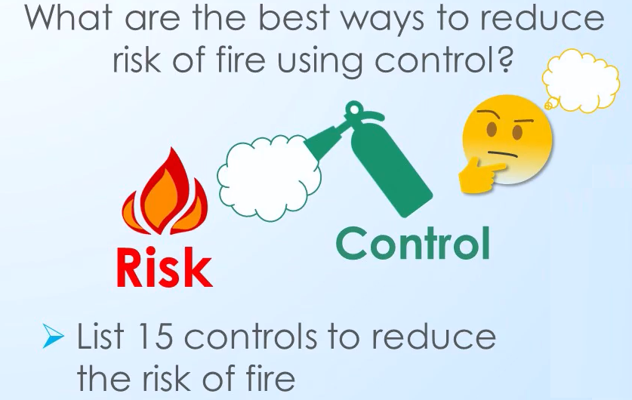
Internal Controls Example

Slide 12
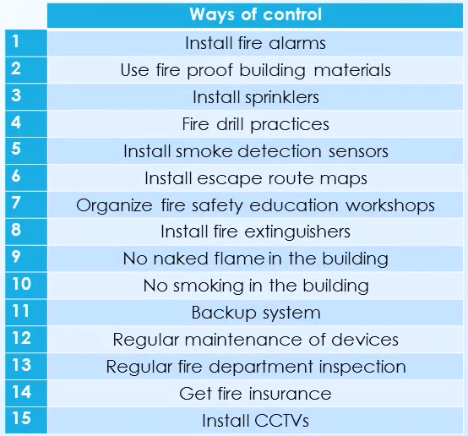
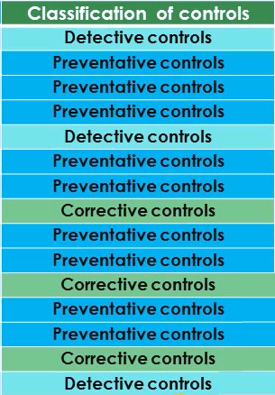
Internal Controls Example (cont’d)

Slide 13
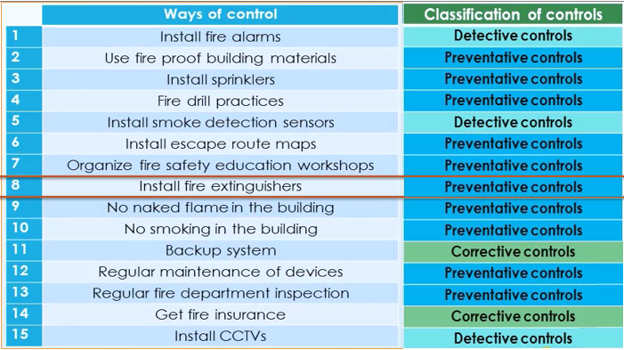
Internal Controls Example (cont’d)
Which controls should be
implemented before others???
Rank them.
Preventive controls should
come before detective ones and
finally corrective.
Use mix if them.

Slide 14
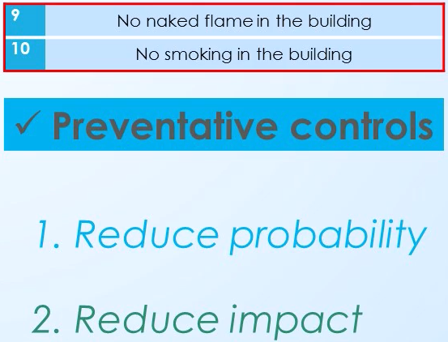
Internal Controls Example (cont’d)
Most desire controls to reduce the risk

Slide 15
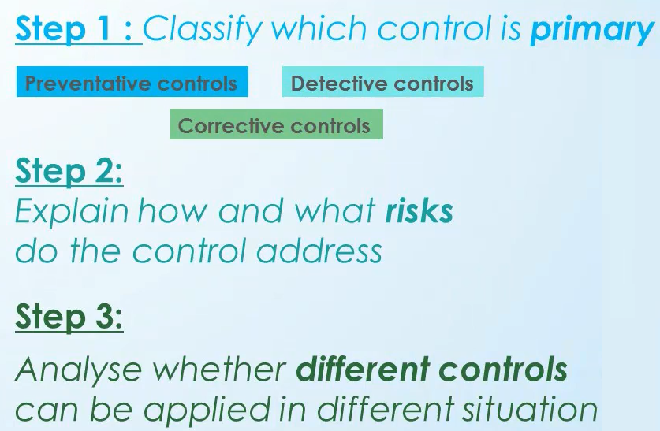
How to Identify Internal Controls?

Slide 16
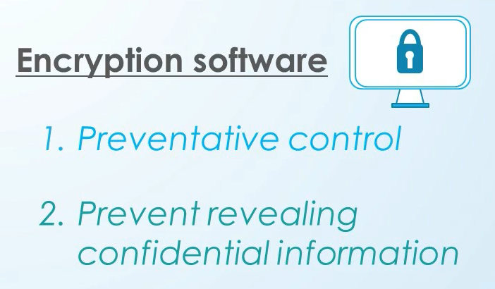
Internal Controls Example -1

Slide 17
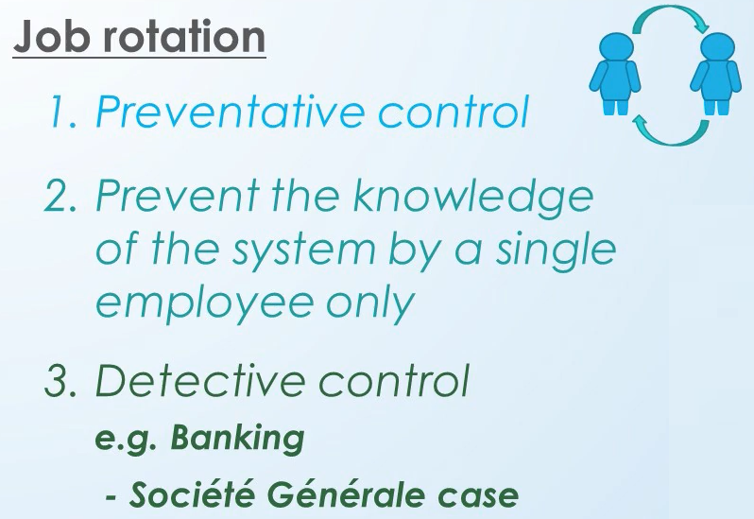
Internal Controls Example -2

Slide 18
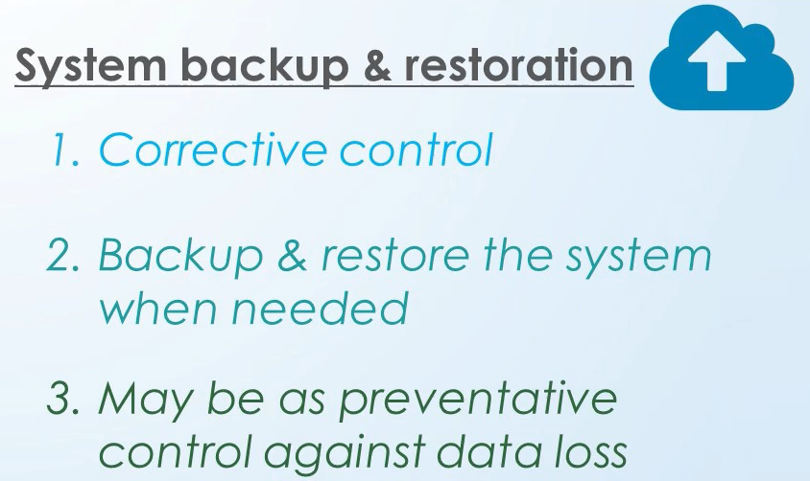
Internal Controls Example -3

Slide 19
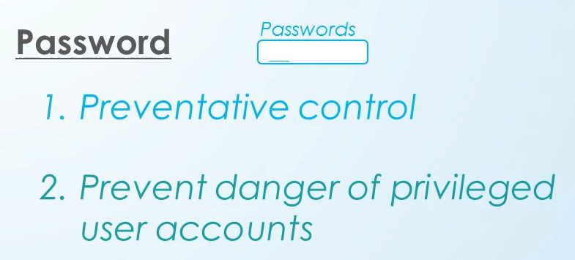
Internal Controls Example -4

Slide 20
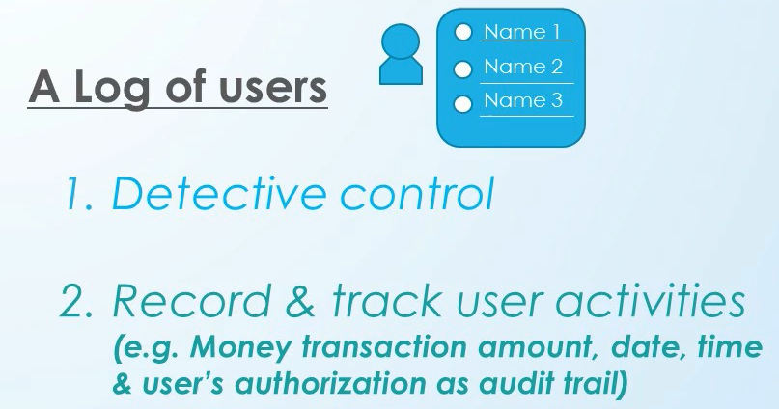
Internal Controls Example -5

Slide 21
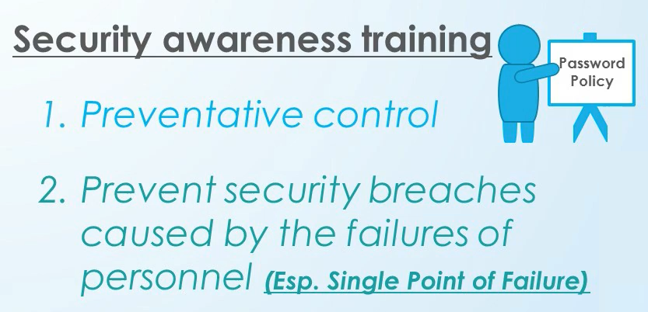
Internal Controls Example -6

Slide 22
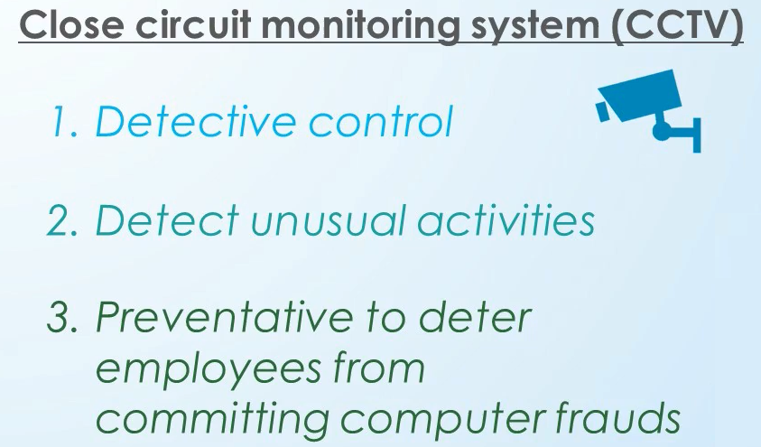
Internal Controls Example -7

Slide 23
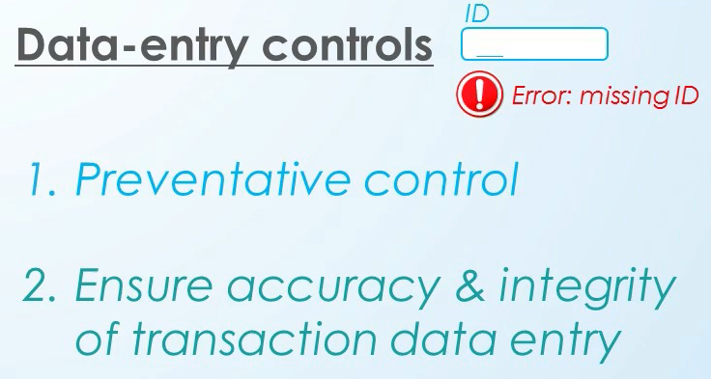
Internal Controls Example -8

