Slide 1
Information System Auditing
Course: Information Systems Engineering
Prepared by Dr. Abdo Darbooli

Slide 2
Course Topics
• Introduction to Information Systems (IS) Auditing
  Risk in Information Systems
  Internal Controls of Information Systems
• IS Auditing Procedure
• Business Application Development and the Roles of IS Auditors
  Business Application Development Process
  Risk of Business Application Development
  Role of IS Auditors in Business Application Development
• IS Maintenance and Controls
  IS Maintenance Practices
  Change Management
  IS Controls

Slide 3
Today’s Topics
• Introduction
• General IS Audit Procedures
• Audit Areas and Subjects
• Compliance and Substantive Testing
• Evidence

Slide 4
Acknowledgment
This course is in based on:
  “Information Systems Auditing, Controls and Assurance” by Prof. Garvin Percy Dias
    Hong Kong University of Science and Technology

Slide 5
Introduction
Previous lectures:
  Risk Management Process
  Internal Controls
This lecture:
  Assume that you have been hired by an organization to audit their activities
    How are you going to plan your audit?
    What's the procedure that you are going to follow?

Slide 6
IS Auditing
The effectiveness of an information system’s controls is evaluated through an information systems audit.
An audit aims to establish whether:
  Information systems are safeguarding corporate assets
  Maintaining the integrity of stored and communicated data
  Supporting corporate objectives effectively, and operating efficiently.

Slide 7
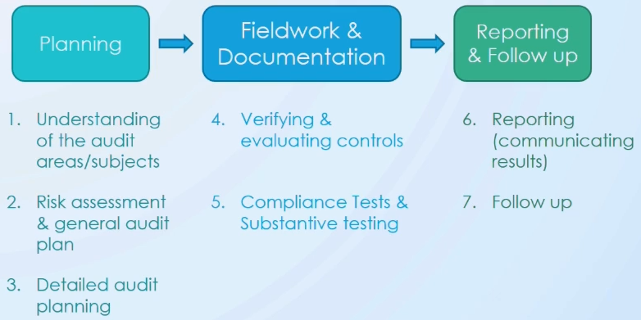
General IS Audit Procedure
Example – You are requested to perform an auditing for a large bank

Slide 8
Understanding the Audit Areas/Subjects
First focus is going to be the area itself (Healthcare, Financial, Airline, etc.)
Audit areas
  Sensitive information
    Customer information (address, credit card numbers, account information, etc.) - Data Privacy Ordinance
  Common risk
    Stealing money, hacking servers
  Regulations
    Banks have to get license from Monetary Authority, so make sure your client follows the regulations
  General IT architecture
    ATM machines, wireless networks, etc.
  Control breach
    Look and learn from things happened in similar organizations

Slide 9
Understanding the Audit Areas/Subjects
Audit subjects
  Sensitive information
  Policies and procedures
    Look at documentation or interview key managers in order to understand these policies
  Business practices
  IT architecture
  Outsource?
    Anything outsourced to a third party (call center for example)
  Interview key managers
  Tour key organization facility

Slide 10
Understanding the Audit Areas/Subjects
Audit subjects (cont’d)
  Prior audit report
    It is a good start because it may contain recommendations, so we can audit or check whether they are implemented
    It is not good all the time, why?
  Environment change
    E-banking

Slide 11
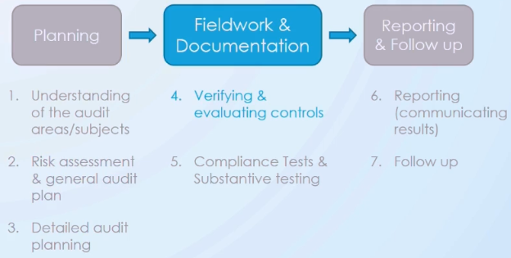
General IS Audit Procedure
Fieldwork and Documentation
  In this phase, we look at the strength and weakness of the controls through specific kinds of testing
Reporting and Follow up
  Write the report and communicate with who asked to audit
    Management or third party

Slide 12
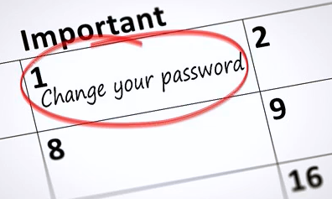
Compliance Testing
Determine whether employees follow policies and procedures of senior management and laws & regulations from regulator
  Done by compliance officer
Example of IT compliance
  Policy: Change password 1-3 months
  Compliance testing: Check if employees follow this policy

Slide 13
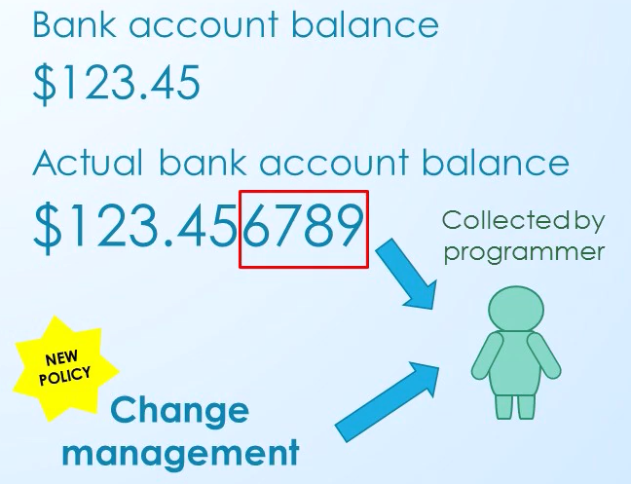
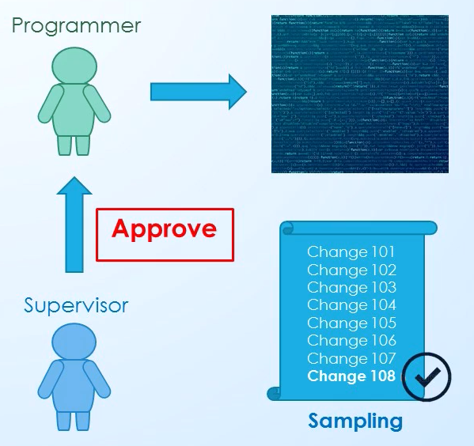
Compliance Testing (cont’d)
Classical case that leads to a new policy

Slide 14
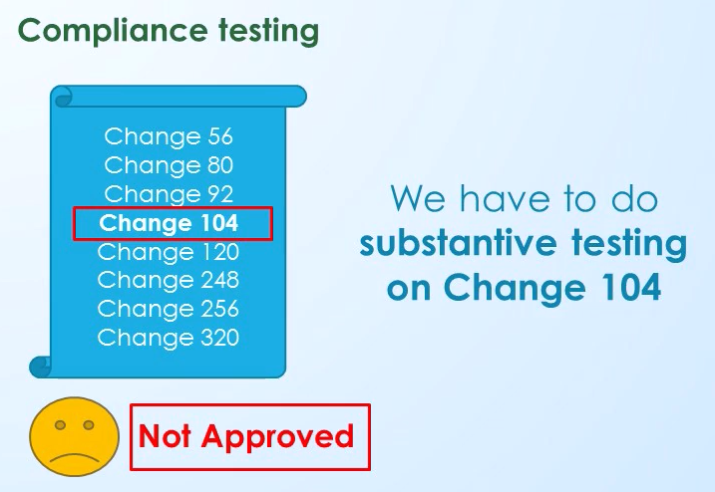
Compliance Testing (cont’d)
Classical case that leads to a new policy

Slide 15
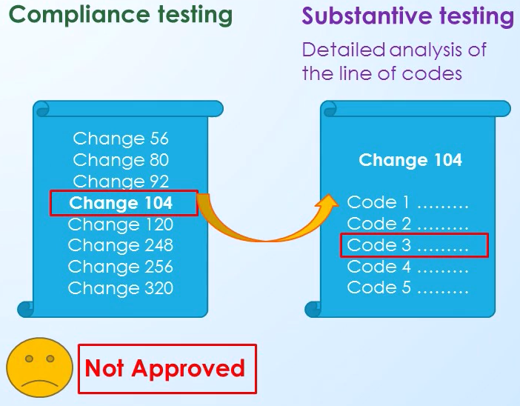
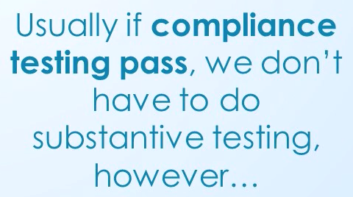
Substantive Testing
Compliance testing fails → Do substantive
Compliance testing pass → we may not do
  Because substantive testing takes a very long time

Slide 16
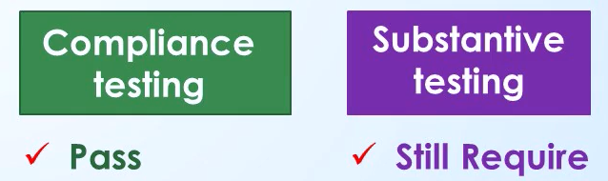
Substantive Testing (cont’d)
What if company has weak or no internal controls?

Slide 17
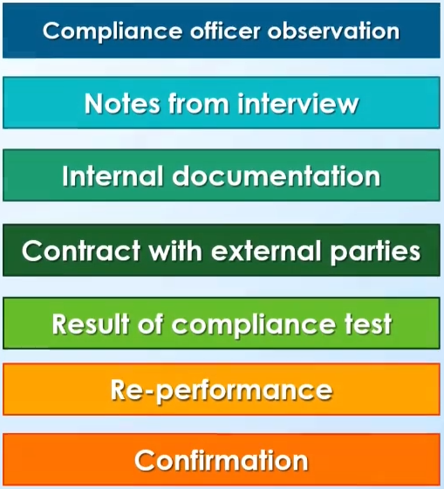
Evidence
What is the purpose of getting evidence?
  It is a requirement that the compliance officer’s conclusion is based on sufficient, competent evidence.
How can we obtain evidence?

Slide 18
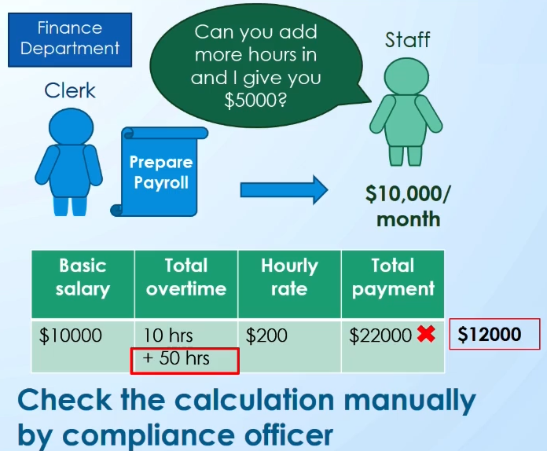
Evidence – Re-performance

Slide 19
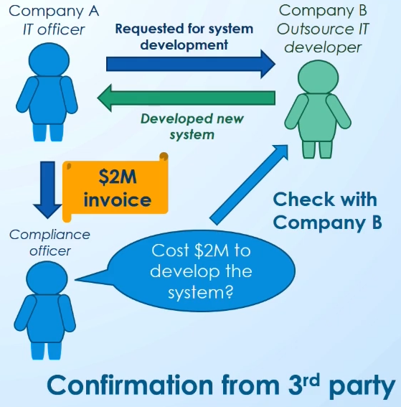
Evidence – Confirmation

Slide 20
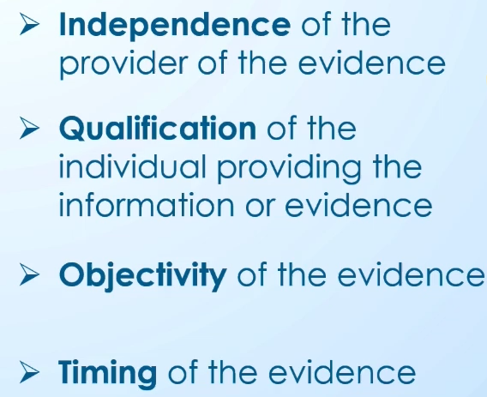
Evidence - Determinants
What are the determinants to evaluate evidence?

Slide 21
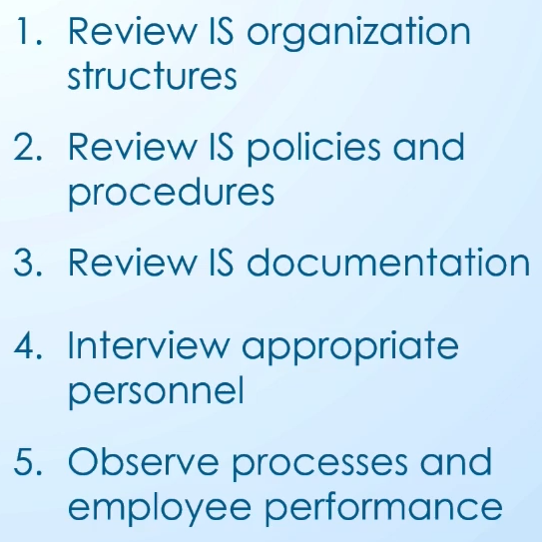
Evidence - Determinants
What are the techniques to get evidence?

